Slide 1
Hed Kandi XS Ibiza 2014
Project/ Dancer’s hair make-up and styling
mood-boards
Date/ 20/05/2014
Prepared by/ Suzy

Slide 2
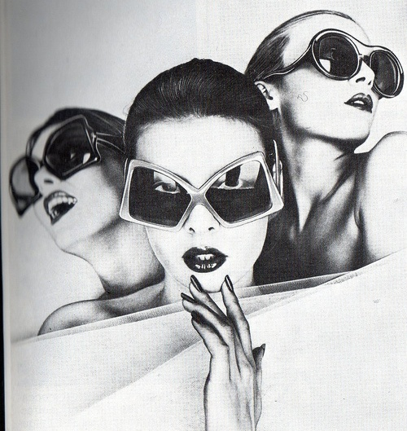
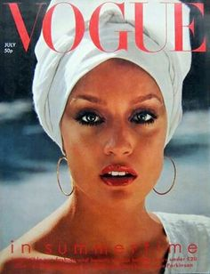
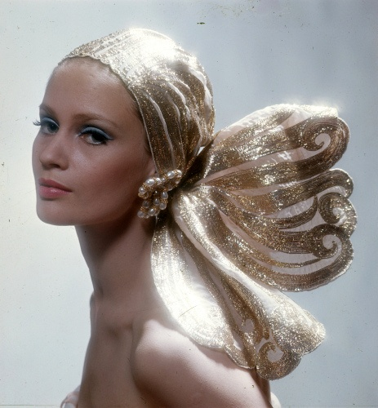
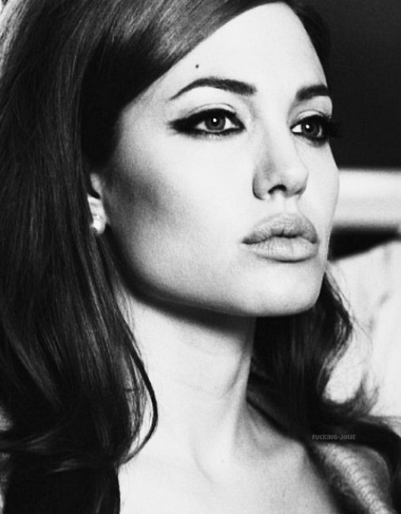
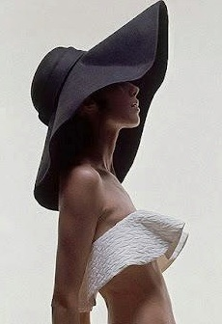
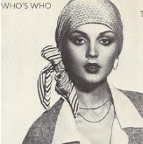
SOPHISTICATED RESORT CHIC – TO EXCESS - HER

Slide 3
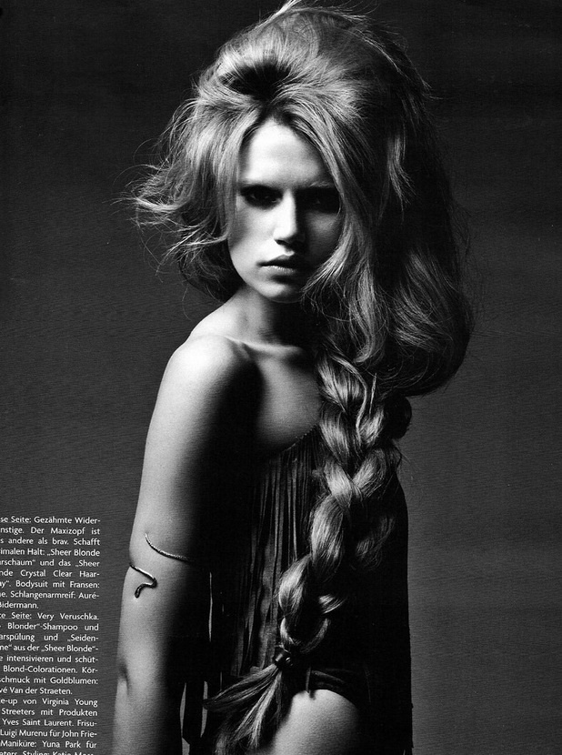
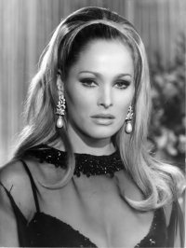
SOPHISTICATED HAIR – TO EXCESS - HER
Sleek, sophisticated,
1970’s inspired glamour
Long slicked back ponytail,
Maybe with large quiff
Giant plait, big curls or
Sleek backcombing
Black false lashes
Bright pink lipstick
Or pale lips

Slide 4
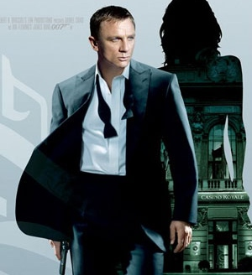
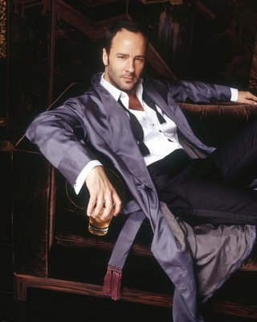
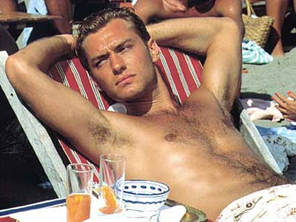
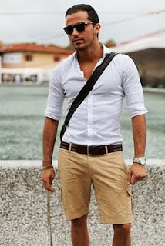
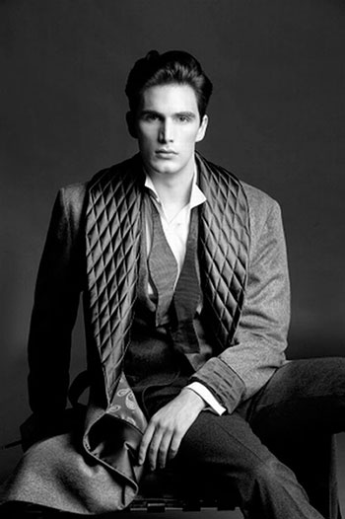
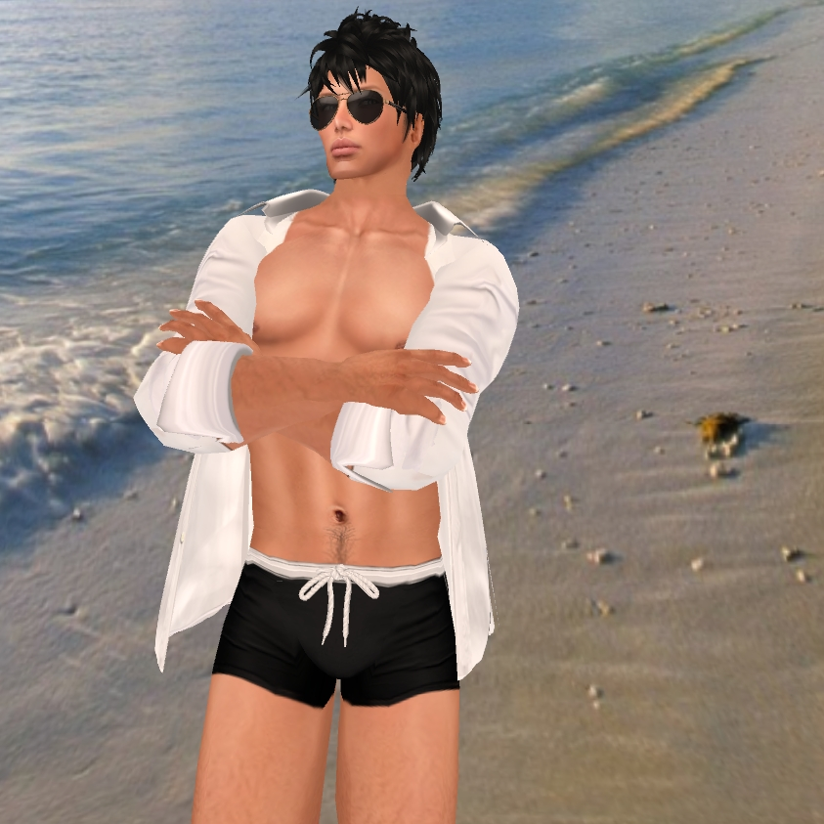
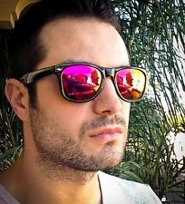
SOPHISTICATED RESORT CHIC – TO EXCESS - HIM
Chic mans’ man….
Resort playboy
Undone aristocrat

